Slide 1





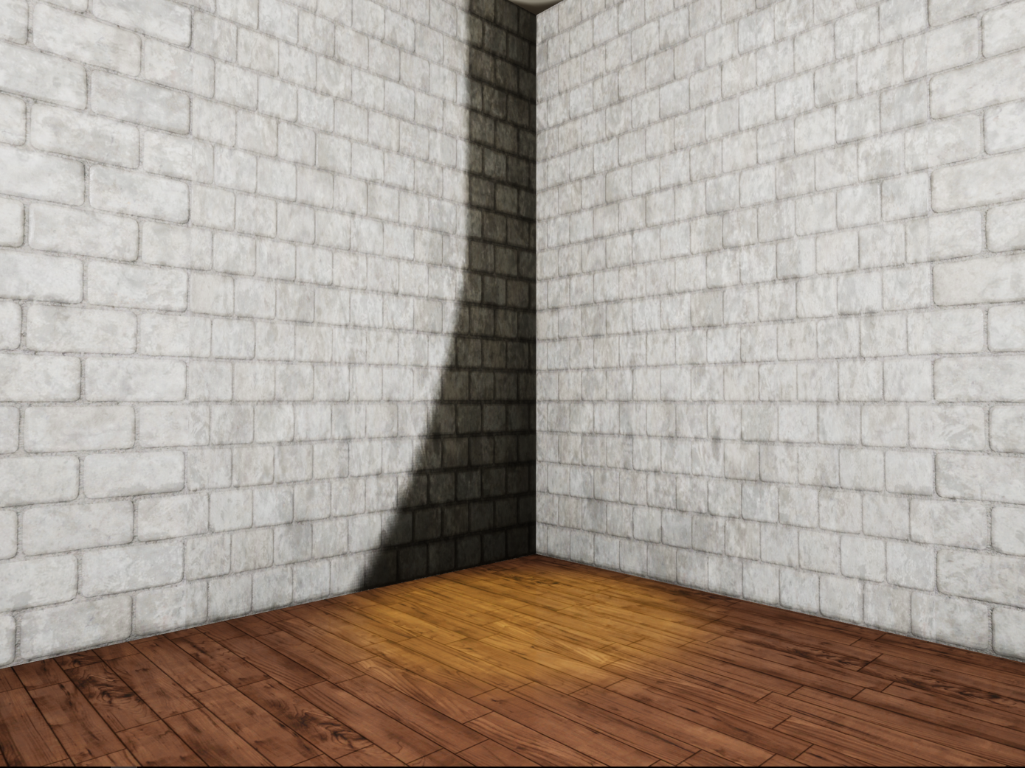
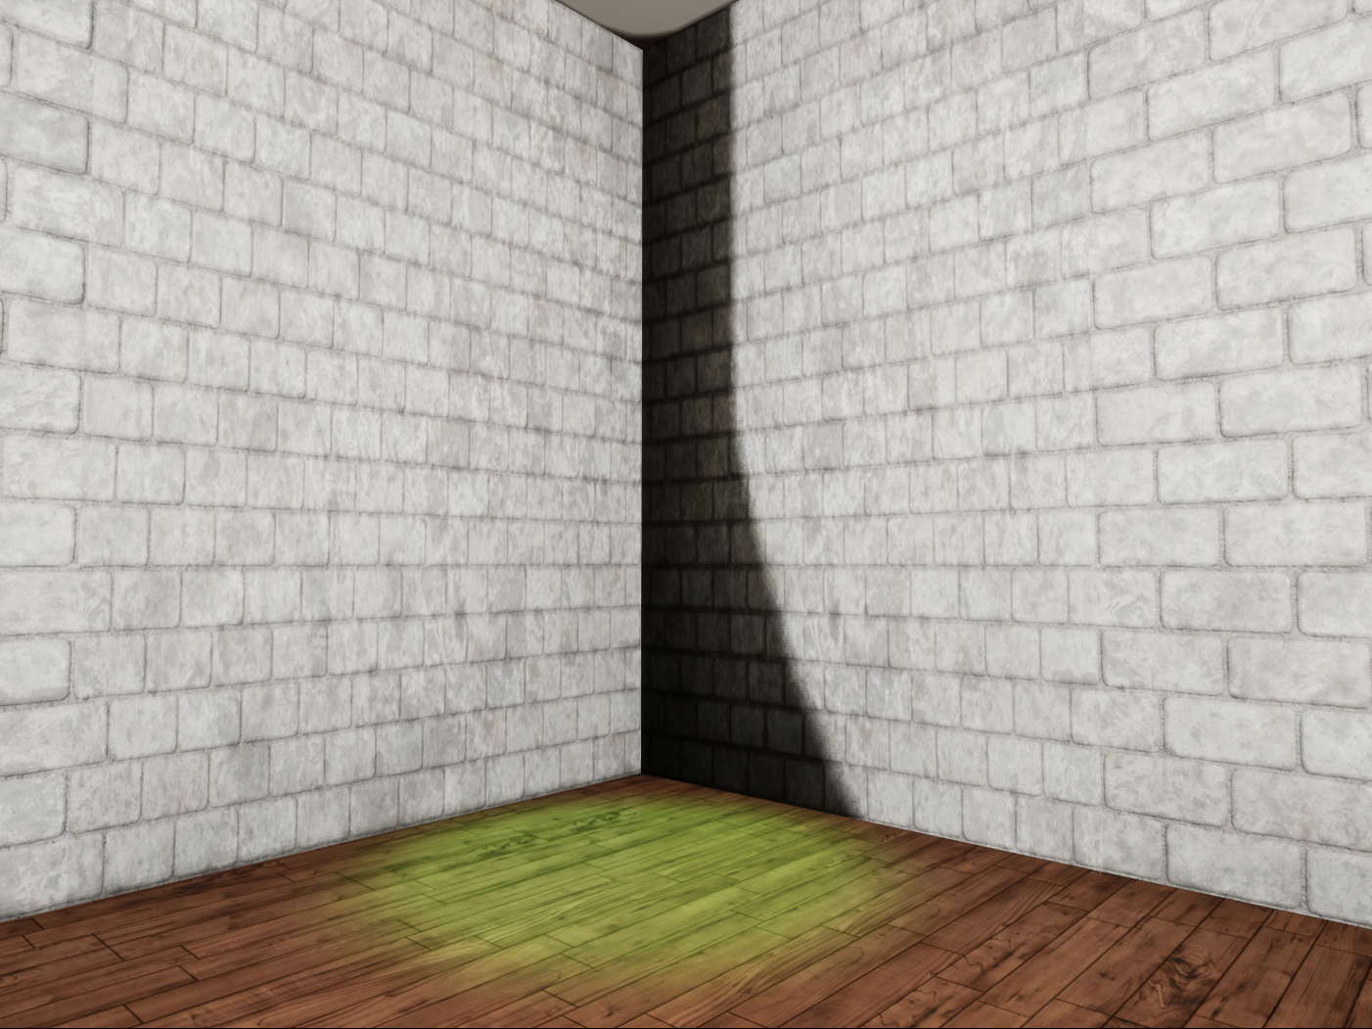
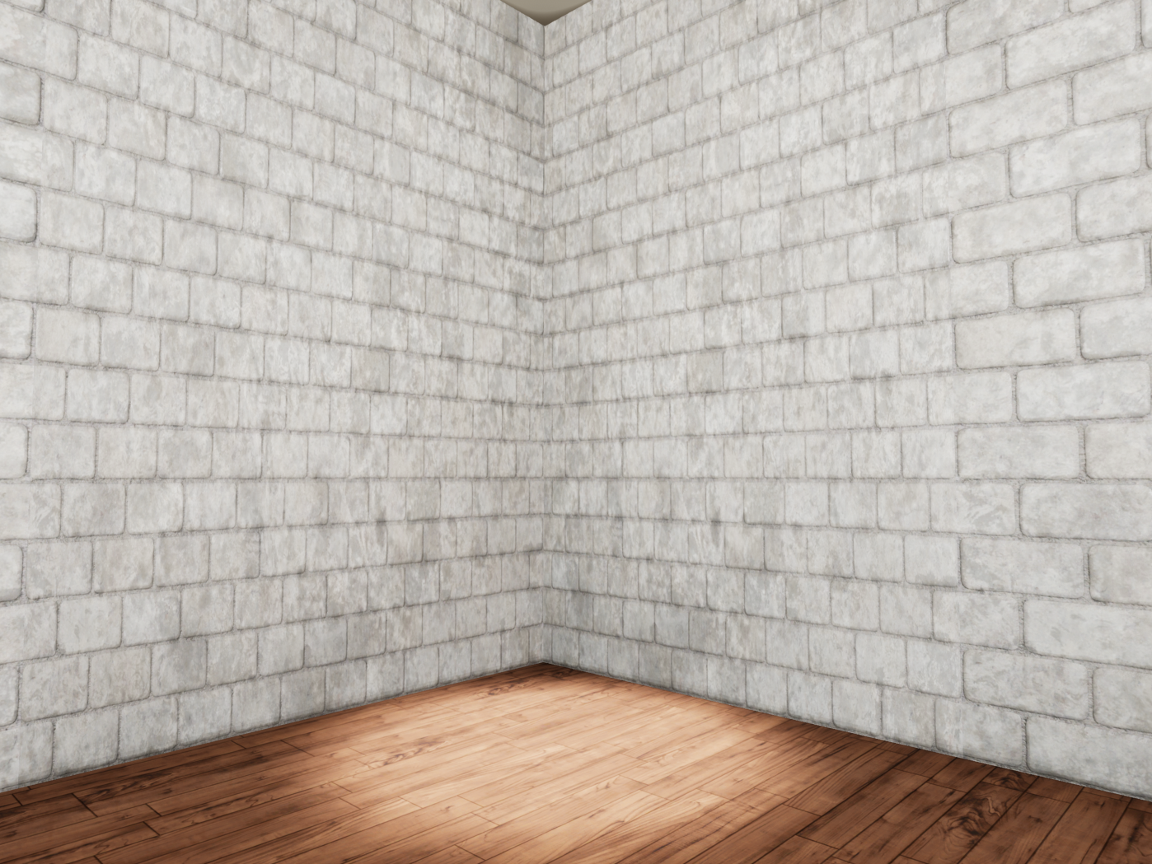
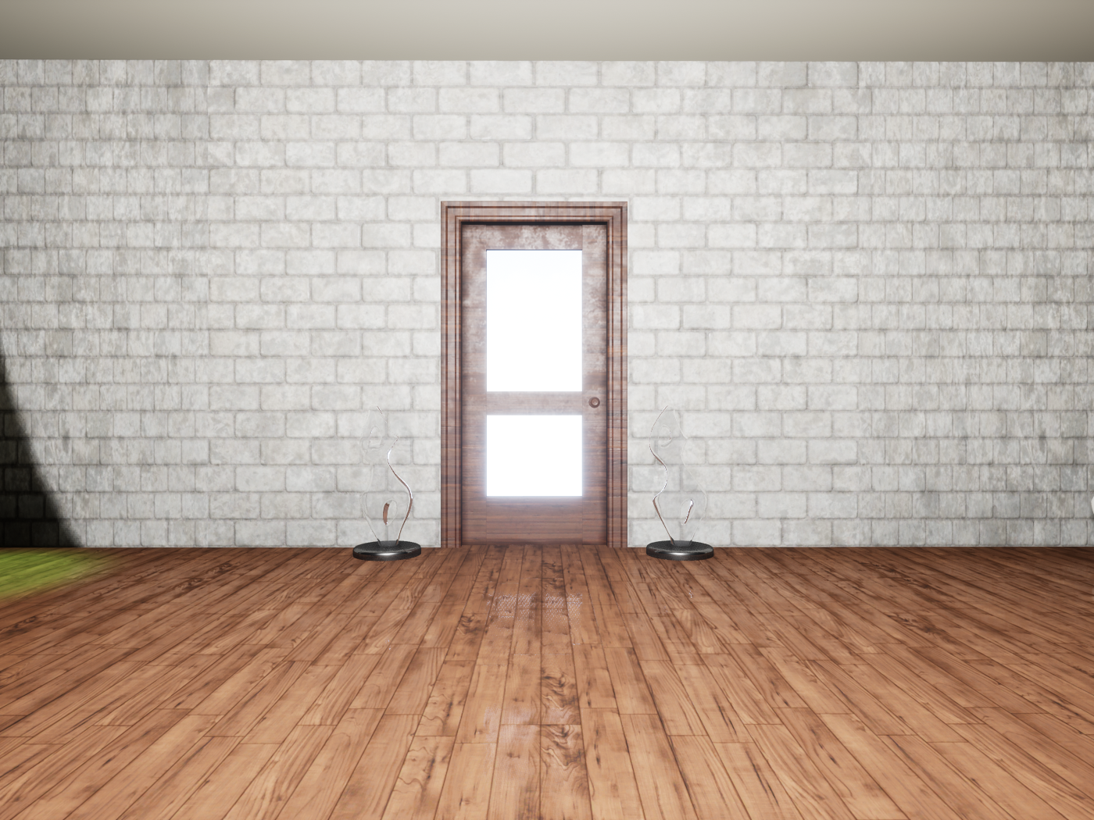
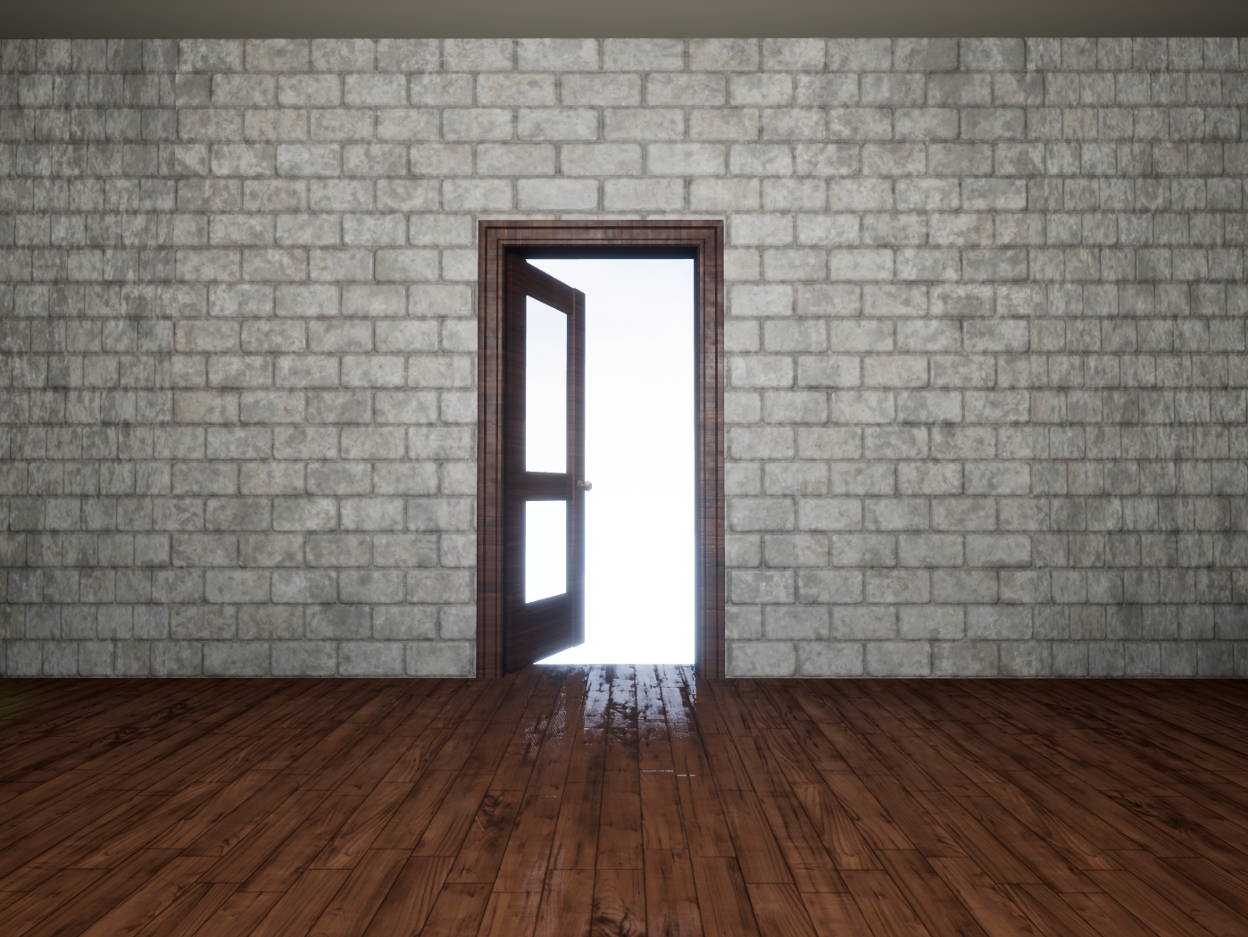
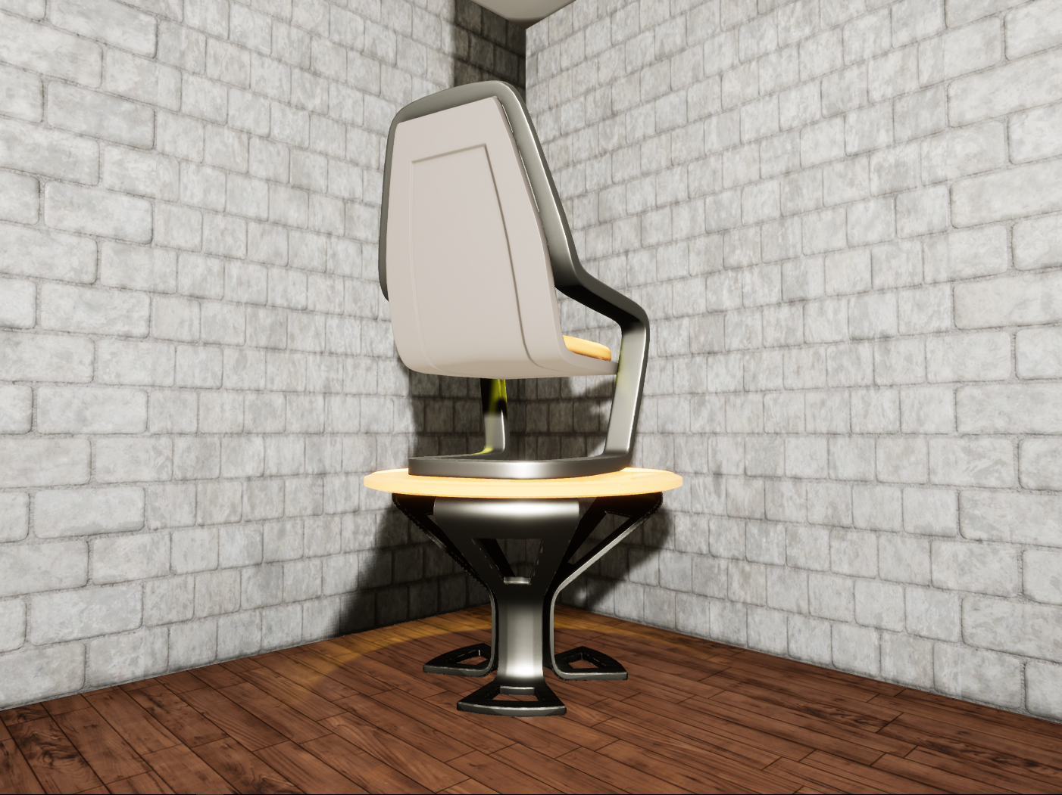
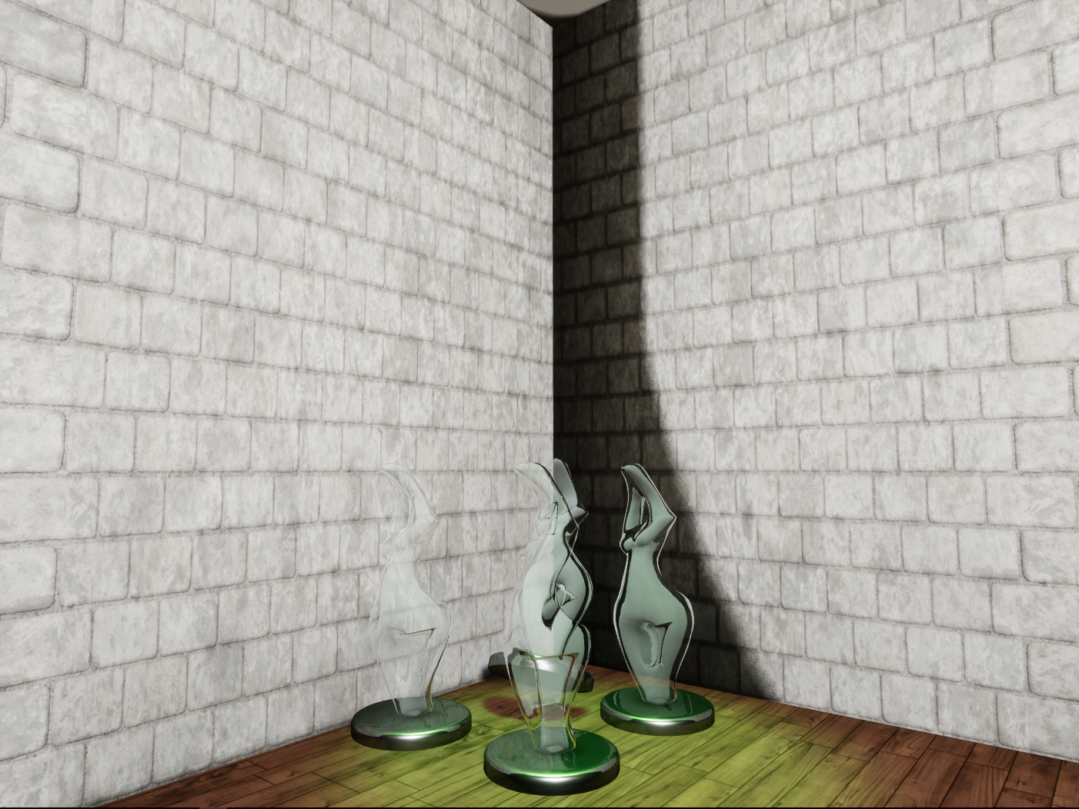
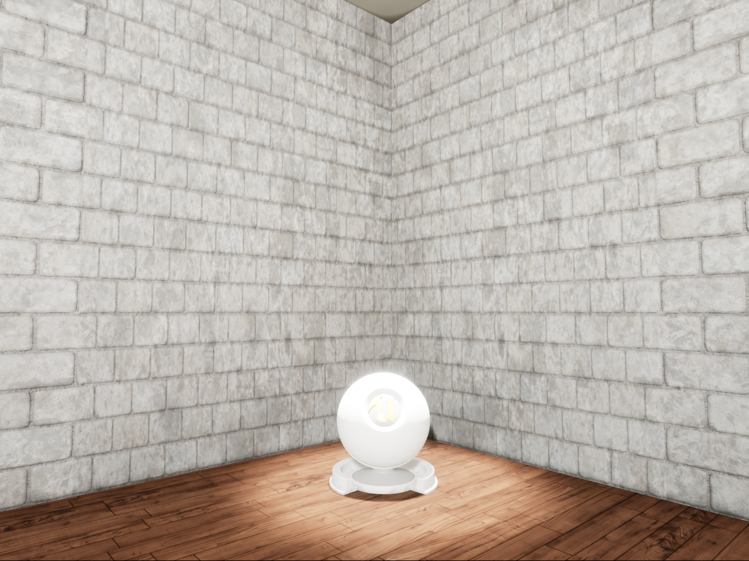



AR-VR-VE for Computer
Science Education 1.0
VIP Junior, 2017, Fall
Santiago Bolivar
sboli001@fiu.edu
Florida International University
Student
Francisco Ortega
fortega@fiu.edu
Florida International University
Mentor / Professor
Problem
Solution
Current Systems
Current statistics show that Computer Science (CS) is on demand, but they also show that there is a low percentage of graduation and interest on minorities such as Women, Black/African American, and Hispanic. Moreover, there is little incentive in to teaching CS on K-12 classrooms.
We propose CScape3D, a video game to promote Computer Science interest and awareness. The core idea of the game is to subconsciously teach the player about basic concepts of CS as they play it. Also, players do not require any previous knowledge of computer science to play it.
Very little of today’s games focus on teaching CS concepts. Most of the games focus on other topics in education such as medicine, math, and phycology. Furthermore, most of these games tend to be instructional or simulators which spark little interest to the players.
Screenshots
Start state, Closed door, No switches have been activated
End state, Open door, All switches have been activated
Above: Yellow Switch
Below: ON if weight is more than 30 lb
Above: Green Switch
Below: ON if objects are more than 3
Above: White Switch
Below: ON if object matches the name
Implementation
Modeling
3D Object Creation
Materials
Game Engine
Environment Creation
Object Placement
Logic and Scripting
Environment Responses
3D Object Optimization
World Properties
Setting Actor Functions
Objects Attributes
Game
Testing
Requirements
Future Work
CScape3D game creation required the following steps:
Planed future work for CScape3D is:
3D Object creation/Modeling
Environment Creation
Lighting (World/Room)
Object collision maps
Pressure Plates and Spotlights
Logic for Pressure Plates
Logic for Object grabber
Logic for Door Opening
Debugging
Code refactoring
Complete 4 rooms with FOR loops, While Loops, Arrays.
Port the system to mobile.
Move the game to Mobile VR.
Move the game to Computer VR
Summary
The purpose behind creating CScape3D is to spark interest on computer science. People are more open to play a game rather than attending a class. Moreover, the game will be able to be played by anyone since the game idea is to reach anyone that has a computer, phone or tablet.
Copyright © 2017 - OpenHID – http://OpenHID.com
Research material and support made possible by Dr. Francisco Ortega.
Thanks to my family and following friends: Paola Jiron, Alban Delamare, Guido Ruiz, Ray Chang-Lau and, Hamilton Chevez.
Notes:
1

